Slide 1

CLASS PRESENTATION
Genichi Taguchi
Pioneering Quality Engineering &
Robust Design

Slide 2


CLASS PRESENTATION
Group Members
IJLAL AHMAD
ABDUL RAFAY ABBASI
ATIF SAJJAD

Slide 3
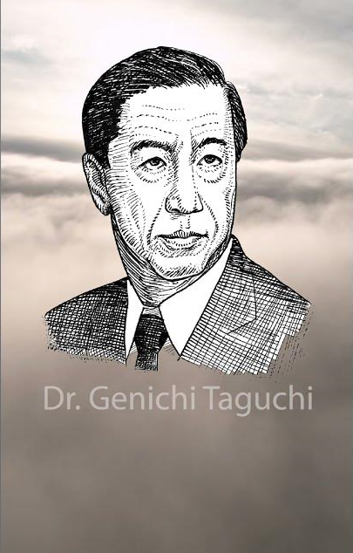
.
CLASS PRESENTATION
Introduction to Genichi Taguchi
Born in Japan in 1924, Genichi Taguchi was a renowned engineer, statistician, and quality expert.
Developed the Taguchi Methods to improve quality through statistical methods.
Introduced the concept of robust design to enhance product and process performance.
Focused on minimizing variability to ensure consistency and reliability in manufacturing.

Slide 4
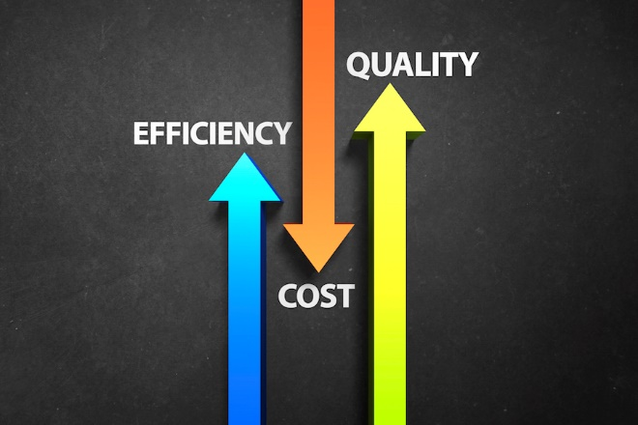
CLASS PRESENTATION
What are the Taguchi Methods
Taguchi Methods focus on improving quality and reducing costs in manufacturing.
Uses design of experiments (DOE) to optimize product and process performance
Aims to minimize variation and defects, even under changing conditions.
Key elements include orthogonal arrays for efficient testing and signal-to-noise ratio (S/N ratio) for measuring reliability.

Slide 5

CLASS PRESENTATION
Robust Design Concept
Robust Design focuses on creating products that perform well under various conditions.
Aims to minimize the impact of variation or "noise" factors (e.g., environment, materials).
The goal is to achieve optimal performance with minimal sensitivity to external changes.
Makes products more reliable and less affected by outside factors.

Slide 6

CLASS PRESENTATION
Key Techniques in the Taguchi Methods
Design of Experiments (DOE) tests multiple factors at once to find the best performance conditions.
Orthogonal Arrays help design efficient experiments covering all factor combinations.
Signal-to-Noise Ratio (S/N Ratio) measures the impact of variations on product performance, with higher S/N indicating better quality.
Loss Function highlights that product deviations from target performance increase costs and stresses minimizing variations.

Slide 7
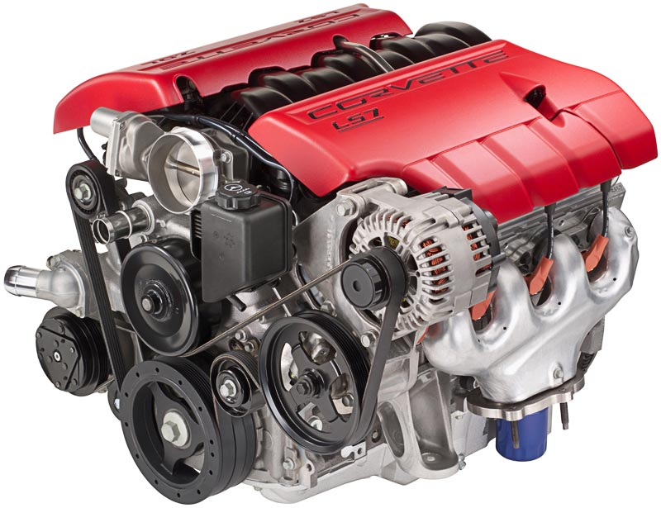
CLASS PRESENTATION
Example of Robust Design
Consider designing a car engine that performs efficiently at varying temperatures and pressures.
Step 1: Identify controllable factors like fuel mixture and engine design..
Step 2: Identify uncontrollable factors such as temperature and air quality.
Step 3: Use DOE and orthogonal arrays to test combinations and optimize design based on S/N ratios.

Slide 8

CLASS PRESENTATION
Applications of Taguchi Methods
Manufacturing: Used in automotive, electronics, and consumer products to improve quality and efficiency.
Healthcare: Applied in medical device design for reliability under variable conditions.
Service Industry: Enhances customer satisfaction by reducing service failures and variability.
Product Development: Helps create products that are robust against variations in materials and processes.

Slide 9

CLASS PRESENTATION
Criticisms of the Taguchi Methods
Over-Simplification: Critics say Taguchi methods may miss complex relationships between factors.
Requires Expertise: Implementing DOE and analyzing results can be difficult without statistical knowledge.
Limited Scope: In complex systems, focusing on variation reduction may not always be the best solution.

Slide 10

Conclusion
CLASS PRESENTATION
Genichi Taguchi’s methods shaped modern quality engineering, focusing on robustness and variation reduction.
The Taguchi Methods optimize design and manufacturing for consistent performance.
Robust design ensures products perform well despite environmental changes.

Slide 11

CLASS PRESENTATION
THE END

